Slide 1






SinoBids Online Auction
Presented by:
Ms.VAYOLA PAUL
IVth Sem MSc.Computer Science St.Mary’s College, Thrissur

Slide 2









Contents
Introduction
Technology used
System Study & Analysis
How SinoBids Online Auction works
Module Description
System Design
System Testing
System Implementation
Conclusion
Scope for further Enhancement

Slide 3



Introduction
What is Auction?
What is Online Auction?
SinoBids as Online Auction Website

Slide 4


What is Auction?
An Auction is a process of buying & selling goods or services by offering them up for bid, taking bids, & then selling the item to the highest bidder
The word “Auction” is derived from the Latin “augeo” which means “I increase” or “I augment”
Here comes your footer  Page 4

Slide 5

What is Online Auction?
Online Auctions are sales transactions involving competitive bidding that are conducted over the Internet.
In this one party that sells products and services,
while another party bids to purchase them .
When time expires, the last participant to have placed a bid wins the item and also pays the final bid price
It is a dynamic pricing environment.
Here comes your footer  Page 5

Slide 6


SinoBids as Online Auction Website
SinoBids Online Auction is a web application which facilitates online auction.
It is a combination of ascending price auction & bidding fee auction
The participants must pay a non-refundable fee to place a small incremental bid by buying the any of the bid packages.
The participants can select any one product, choose one of the auction types on
the product, select the any package they bought and place bid.
Time expires, the last participant who place highest amount
will win the auction.
Here comes your footer  Page 6

Slide 7

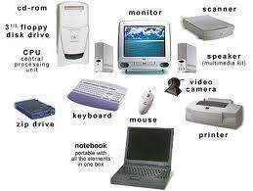
Technology used
Hardware specification
Software specification
Here comes your footer  Page 7

Slide 8
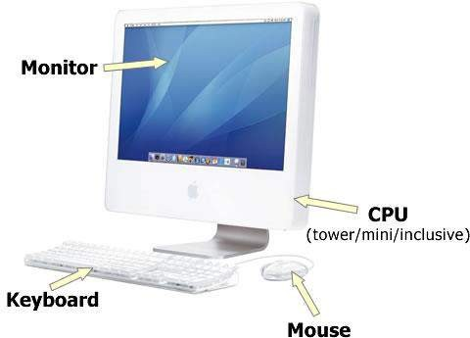
Hardware Specification
System :
Processor :
Bus speed :
Motherboard :
Memory :
Hard Disk Drive : Key Board :
Monitor :
CD_ROM :
Mouse :
HP PC
Pentium(R) Dual-Core CPU 2.50GHZ
Intel DG33BU
2 GB RAM
160 GB
104 keys
18.5 LCD HP v185e
HP DVD RW
HP Optical Scroll Mouse
E5200 @2.50GHZ
Here comes your footer  Page 8

Slide 9







Software Specification
Operating system Browser
Web Server
Server side Scripting Client side Scripting Database Layer Connection Protocol Platform Tool Used Documentation
:
:
:
:
:
:
:
:
:
WINDOWS XP
Any HTTP Browser XAMPP Server PHP
JavaScript and AJAX MySQL version 5.4.41
TCP/IP, HTTP, SMTP, POP3, WAP
Dreamweaver Microsoft Word 2003
Here comes your footer  Page 9

Slide 10





System Study & Analysis
Need For SinoBids Online Auction
Online Auction Advantages
SinoBids Online Auction Features
Feasibility Study
Here comes your footer  Page 10

Slide 11



Need for SinoBids Online Auction
Traditional auctions, held in stuffy courtrooms, where
crowded with bidders and sellers with full of noise.
Only invite people from local communities were present
Require a considerable amount of money to stock and
store such a wide variety of products.
Many geographical limitations & time constraints.
Need
Here comes your footer  Page 11

Slide 12

Online Auction Advantages
No geographical constraints
Time benefits
Intensity of social interactions
Large number of Users
Get Started Quickly
Save Money
Uncover New Business Opportunities
Good control of bidder’s submissions
Easy comparison of bids
Ease and speed of communication to multiple bidders
Here comes your footer  Page 12

Slide 13








SinoBids Online Auction Features
Affordable seven Bid Packages
Group & Garden Facilities
Earn by site reference.
The webpage does not have to be refreshed for the user to see latest bidding
How to play the auction.
Advanced Search & Product list filtering
Consignment Facilities
Mailing & Messaging Facilities
Shipping prices can be set up according to shipping zones
User can select their own auctiontype for bidding: Entry Auction, Free Auction,
Peak Auction, Fixed Price Auction, Live Only Auction, Bonus Auction & Sealed Price Auction
Here comes your footer  Page 13

Slide 14







SinoBids Online Auction Features
Secure bidding environment
The ability to submit more than one bid
Users can have their own Watchlist
Separate listings for: My Bids, My Watchlist, My Won Bids, My Wantlist
User can gain badges if the condition satisfy
Feedback rating reputation
Newsletter feature
Extended User Profile & User Interaction
Poll of the week
User can submit their the wanted items
Address Book & Testimonials
User Suggestions
Here comes your footer  Page 14

Slide 15


Feasibility Study
Feasibility study is a test of a system proposal according to its workability, impact on the
organization, ability to meet user needs, and effective use of resource
Technical Feasibility - The site is technically feasible because it has immense computer facilities equipped with many features such as
easy searching of an auction item
choice for bid package and auction type for bidding
social interaction through groups and other matters
money and time consuming which make this site both interactive and user friendly
Here comes your footer  Page 15

Slide 16

Feasibility Study
Operational Feasibility - Using buttons and links throughout the application programs enhances operational feasibility
Economic feasibility -This site is economically feasible since
it does not require any initial cost for registration.
It saves money and time for users.
In this site the auction starts from the initial price as low and
is bid up by successive bidders.
The final bid price will be usually significantly lower than the retail price of the item.
The auctioneer receives income both in the form of the fees collected for each bid and in the form of payment for the winning bid.
Here comes your footer  Page 16

Slide 17








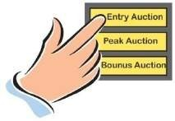


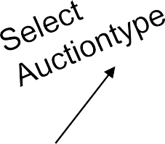







How SinoBids Online Auction works
Admin
Customer 2
DB
Make Winner
(Customer 3)
Customer 3
Bid Pack
Customer1
Register
Login
Select Product

Slide 18

Module Description
User Module
Administrator module

Slide 19






User Module
User Registration module
User Login module
Auction module
Bidding
Watchlist
Wantlist
Search
Badges
User Bids & Bid Package
Won Auction
Payment

Slide 20


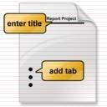



User Module
User Account module
Personal Details
Account setting
About me
Address Book
Review module
Feedback Profile
Testimonial
Survey
Poll

Slide 21






User Module
Consignment Module
Garden Module
Messaging Module
Site reference
Mailing
Messaging
Group module
Wall
Email friends
View members
Remove User

Slide 22




Administrator Module
Login Module
Site setup Module
Product Detail Module
Product Details
Want item
Consignment
Todays Special
Category Details Module
Category Details
Suggested Category
Newsletter Module

Slide 23

Administrator Module
Bid Package Details Module
Bid Package Details
User Request Bid Pack
Group Details Module
Group Details
View Group members and wall
User Suggested group
Garden Management Module
New ideas
User Comments & feedback status

Slide 24


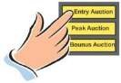

Administrator Module
User Module
View Profile
Activate/Suspend
Send message, email, Payment remainder
View bids, auction history,
Auction Module
Manage Auction type
Set Peak Auction & Live Only Auction
View pending winners & Make winners
Manage & assign Badge , Shipping charge & Payment Details
Survey Module
Survey Details, Testimonial, Poll & Feedback

Slide 25
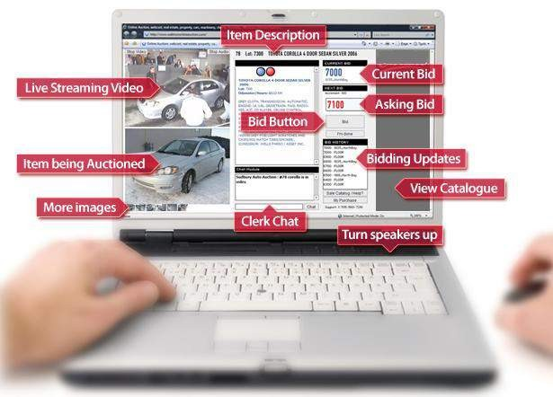




System Design
Data Flow Diagram
Input Design
Output Design
Database Design
Normalization

Slide 26



Data Flow Diagram
Level 0: Context Level Diagram
Details
SinoBids Online Auction
Details
Admin/User
 | Requested information
Database
Retrieve information

Slide 27
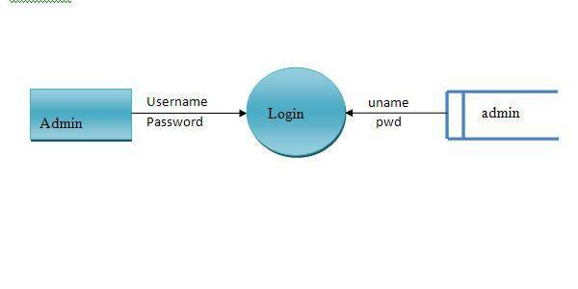
Level 1: Administrator
Level 1.1

Slide 28
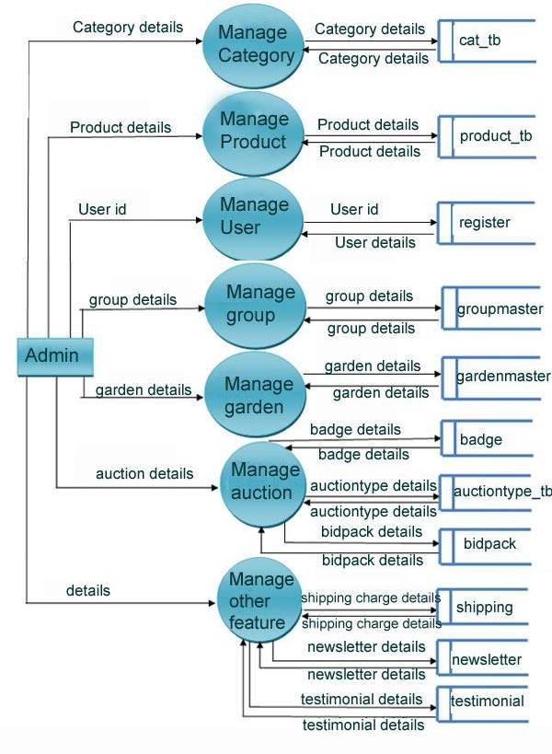
Level 1.2

Slide 29
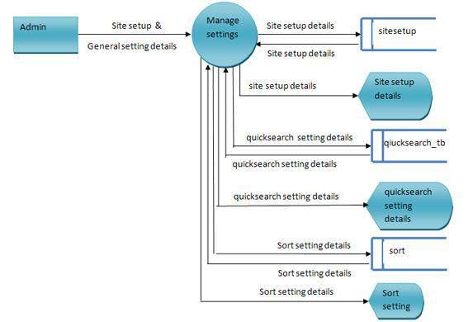
Level 2.1 : Site Setup

Slide 30
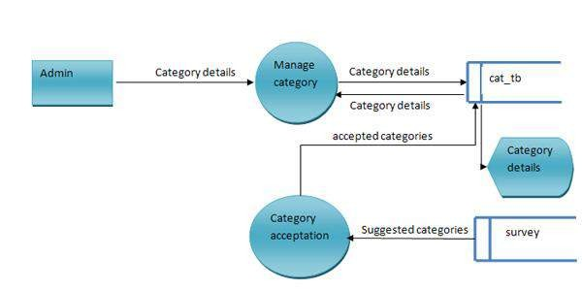
Level 2.2 : Category Management

Slide 31
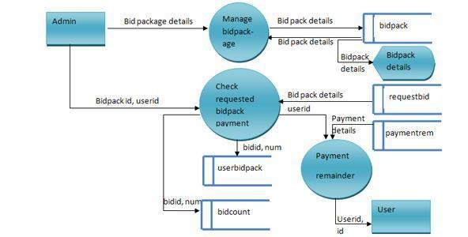
Level 2.3 : Bid Package

Slide 32
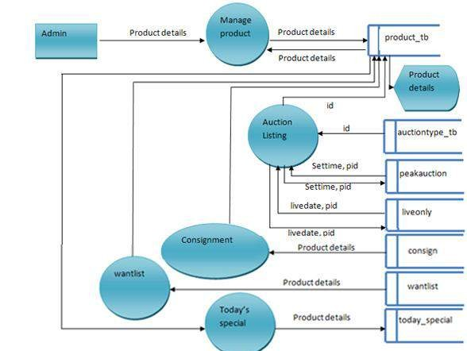
Level 2.4 : Product Managements

Slide 33
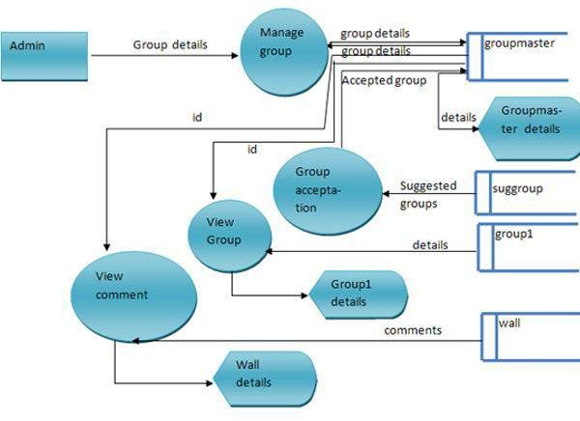
Level 2.5 : Group Management

Slide 34
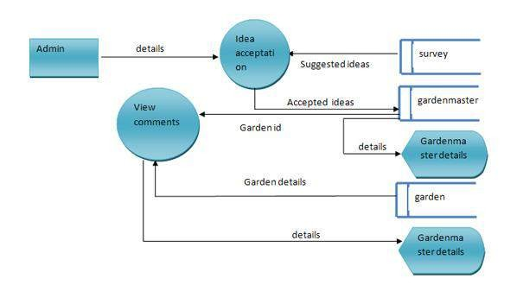
Level 2.6 : Garden Management

Slide 35
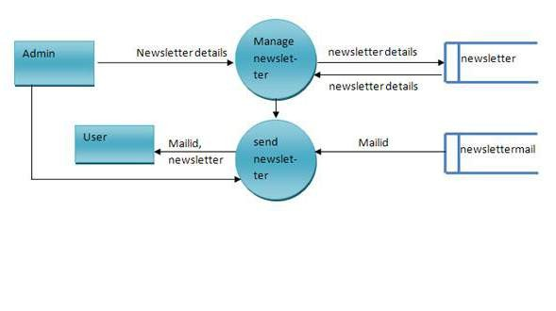
Level 2.7 : Newsletter Management

Slide 36
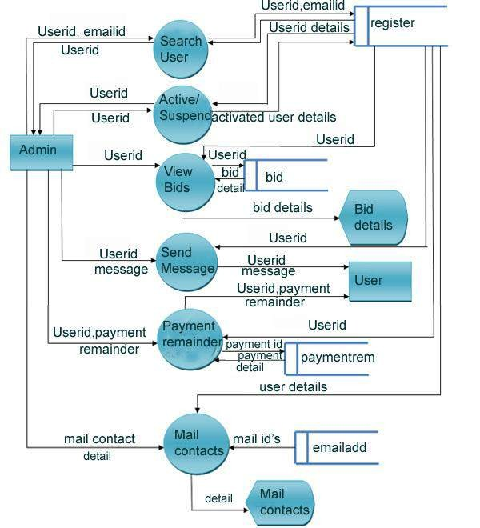
Level 2.8 : User Management

Slide 37
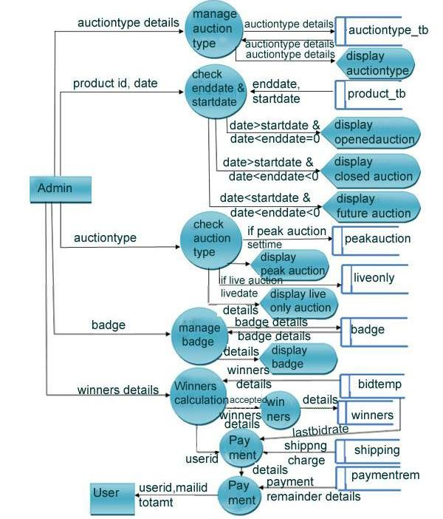
Level 2.9 : Auction Management

Slide 38
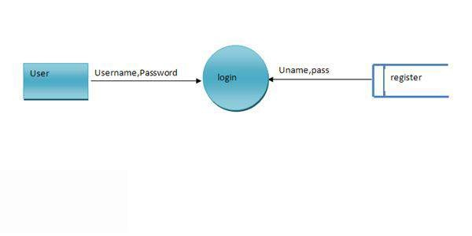
Level 1: User
Level 1.1

Slide 39
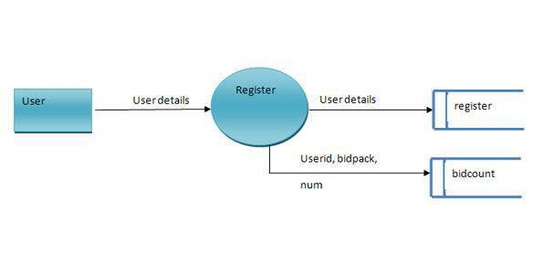
Level 1.2

Slide 40
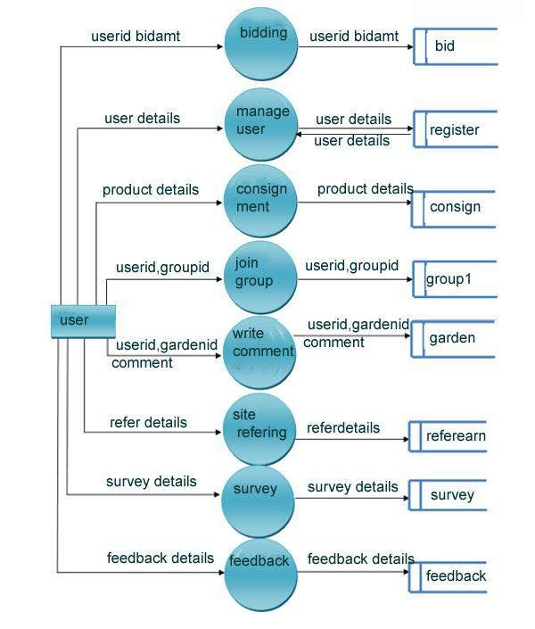
Level 1.3

Slide 41
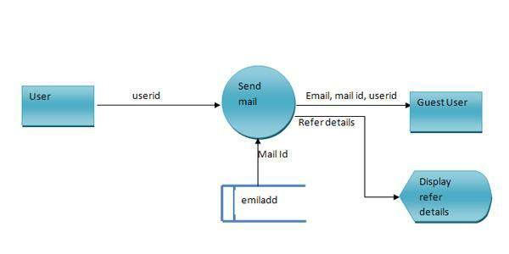
Level 2: User
Level 2.1 : Refer & Earn

Slide 42
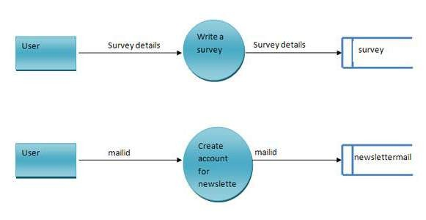
Level 2.2 : Survey
Level 2.3 : Newsletter

Slide 43
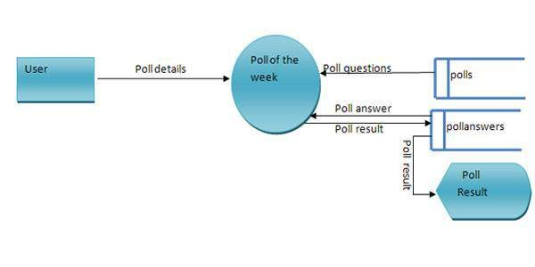
Level 2.4 : Poll

Slide 44
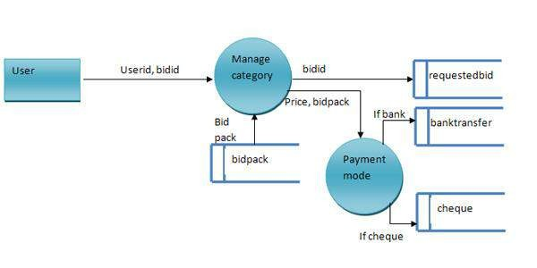
Level 2.5 : Bid Package Buy

Slide 45
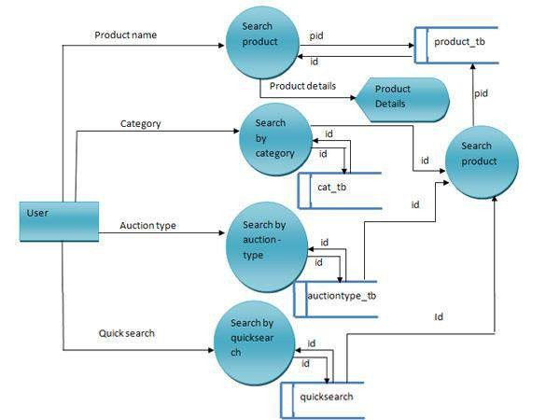
Level 2.6 : Searching Product

Slide 46
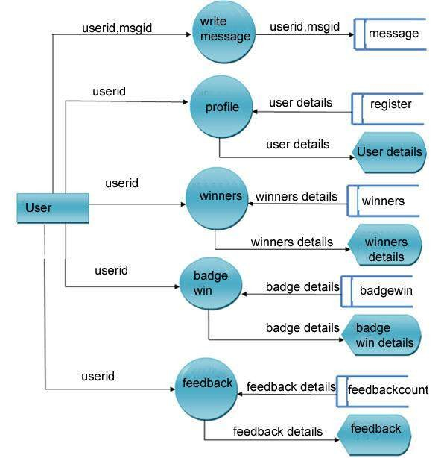
Level 2.7 : Profile Visiting

Slide 47
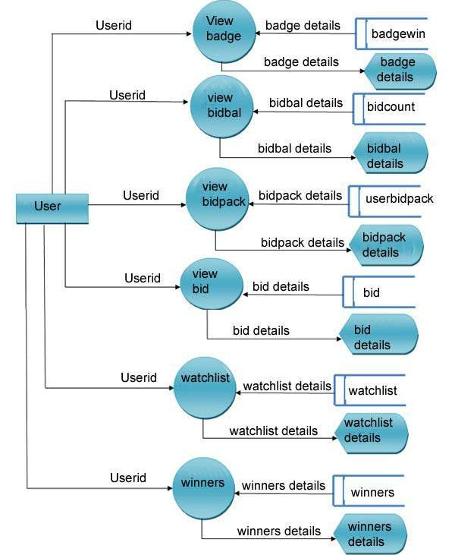
Level 2.8 : My Auction

Slide 48
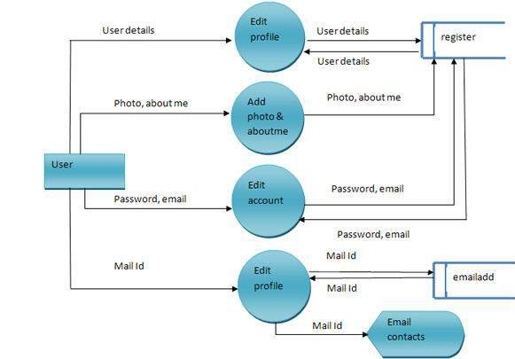
Level 2.9 : My Account

Slide 49
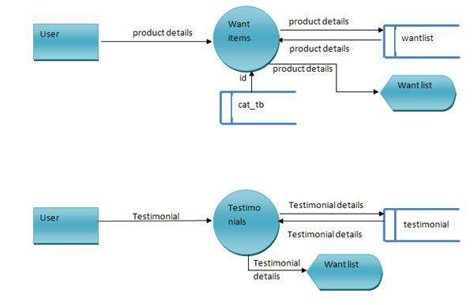
Level 2.10 : Wantitem
Level 2.11 : Testimonial

Slide 50
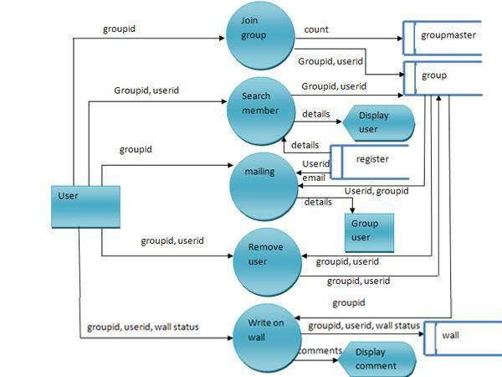
Level 2.12 : Group

Slide 51
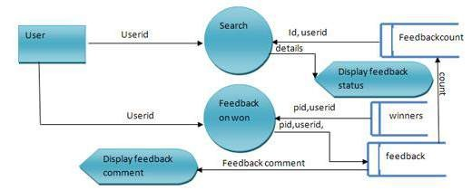
Level 2.13 : Feedback

Slide 52
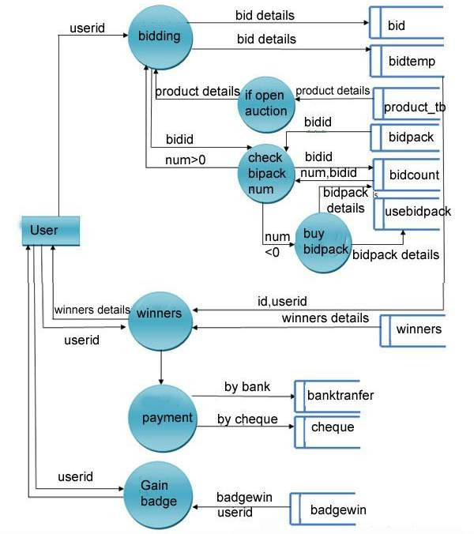
Level 2.14 : Bidding

Slide 53
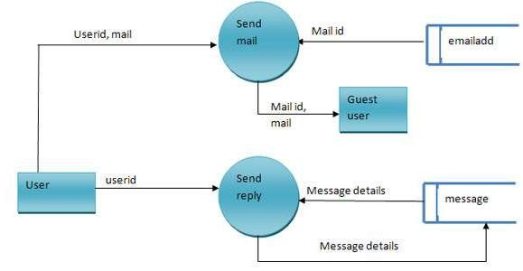
Level 2.15 : Mailing & Messaging

Slide 54
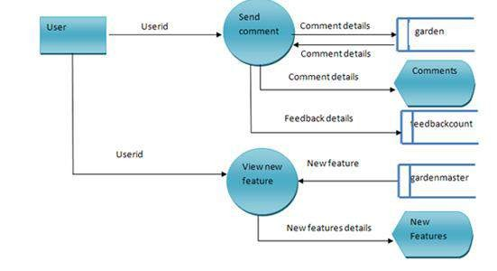
Level 2.16 : Garden

Slide 55


Input Design
User Area
Admin Area

Slide 56
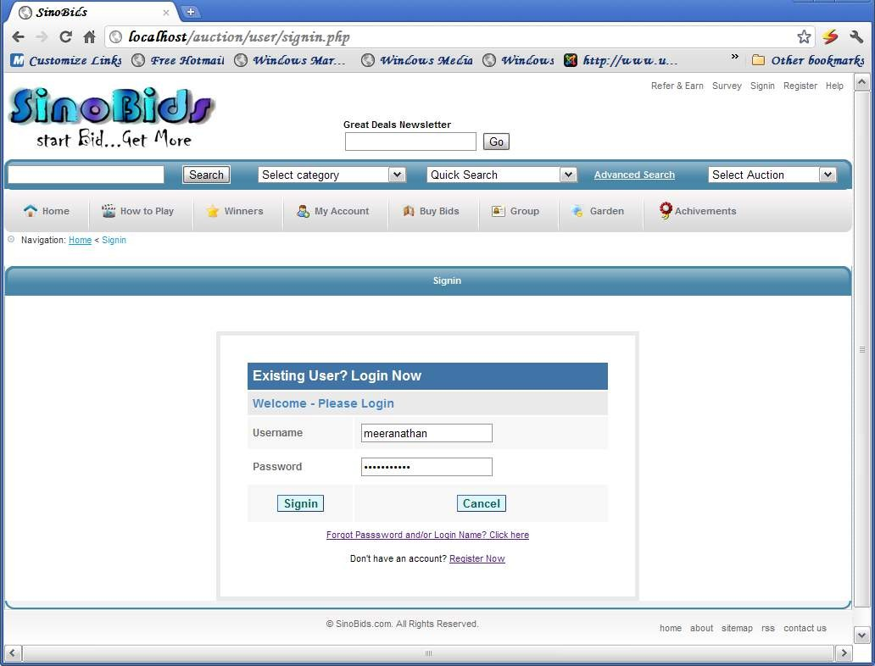

User Area - Input Forms
FORM NAME : Loginform
DESCRIPTION : Used to login to the application.

Slide 57
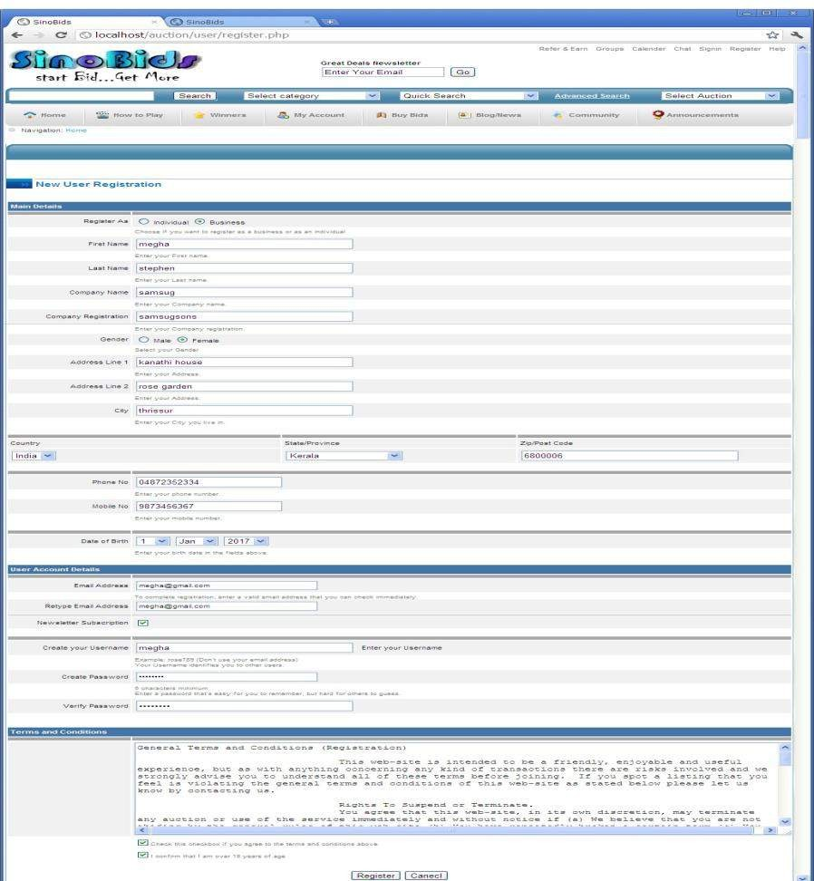
FORM NAME : Registerform DESCRIPTION : Used to create an account.

Slide 58
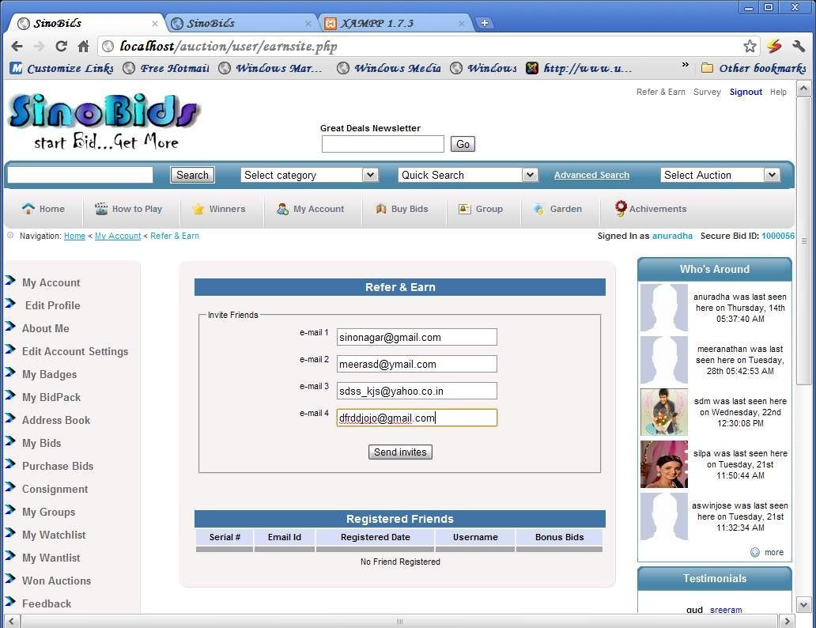
FORM NAME : Refer & Earn DESCRIPTION : Used to refer the site.

Slide 59
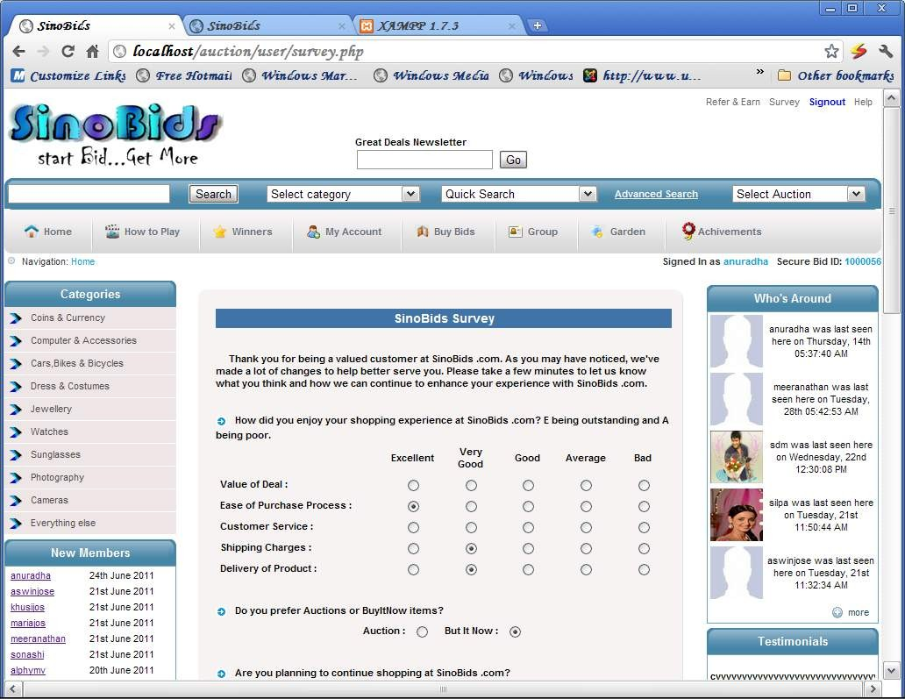
FORM NAME : Survey form
DESCRIPTION : Used to survey about the site.

Slide 60
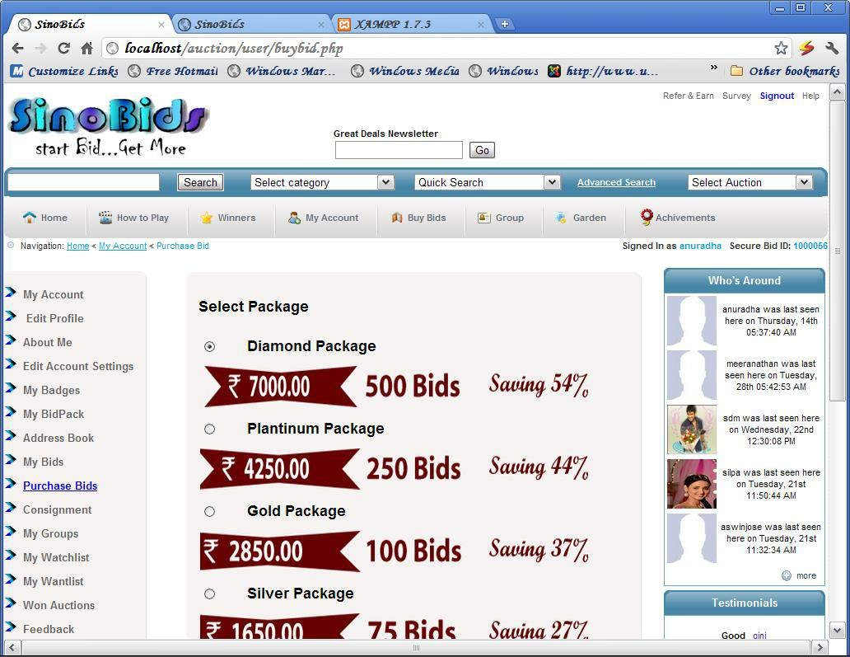
FORM NAME : Buybidpack form DESCRIPTION : Used to buy the bid package.

Slide 61
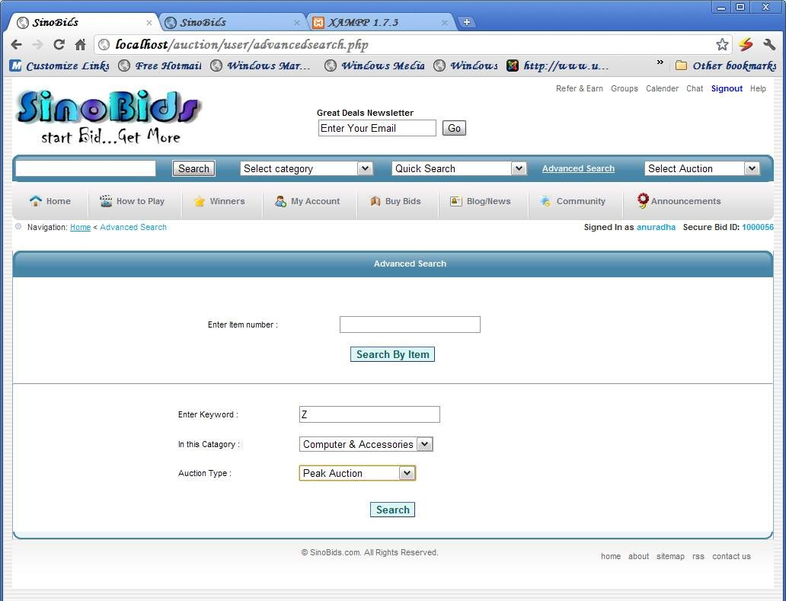
FORM NAME : Search form
DESCRIPTION : Used to search the product

Slide 62
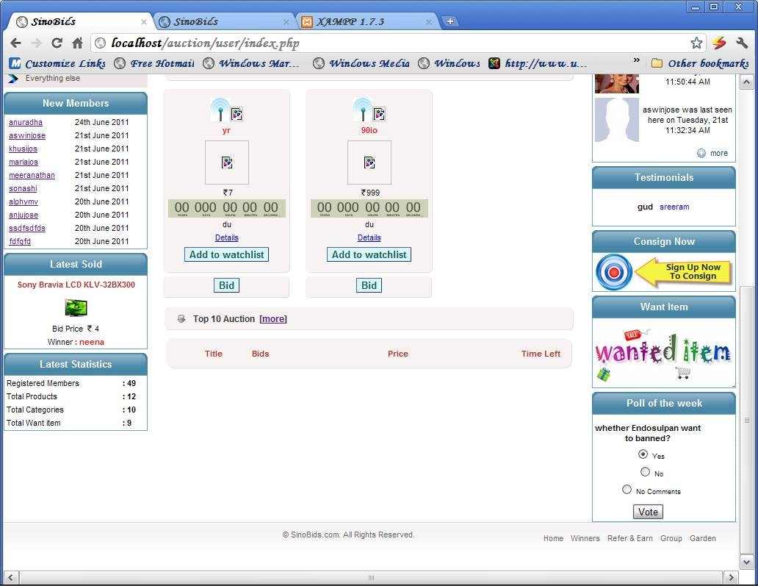
FORM NAME : Poll form
DESCRIPTION : Used to Poll of the week

Slide 63
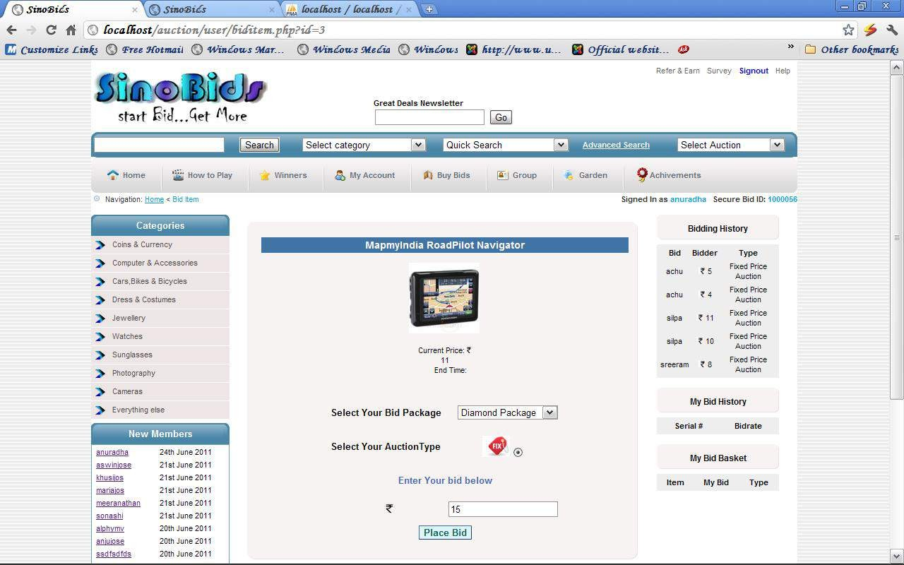
FORM NAME : Bid form DESCRIPTION : Used to Place the bid

Slide 64
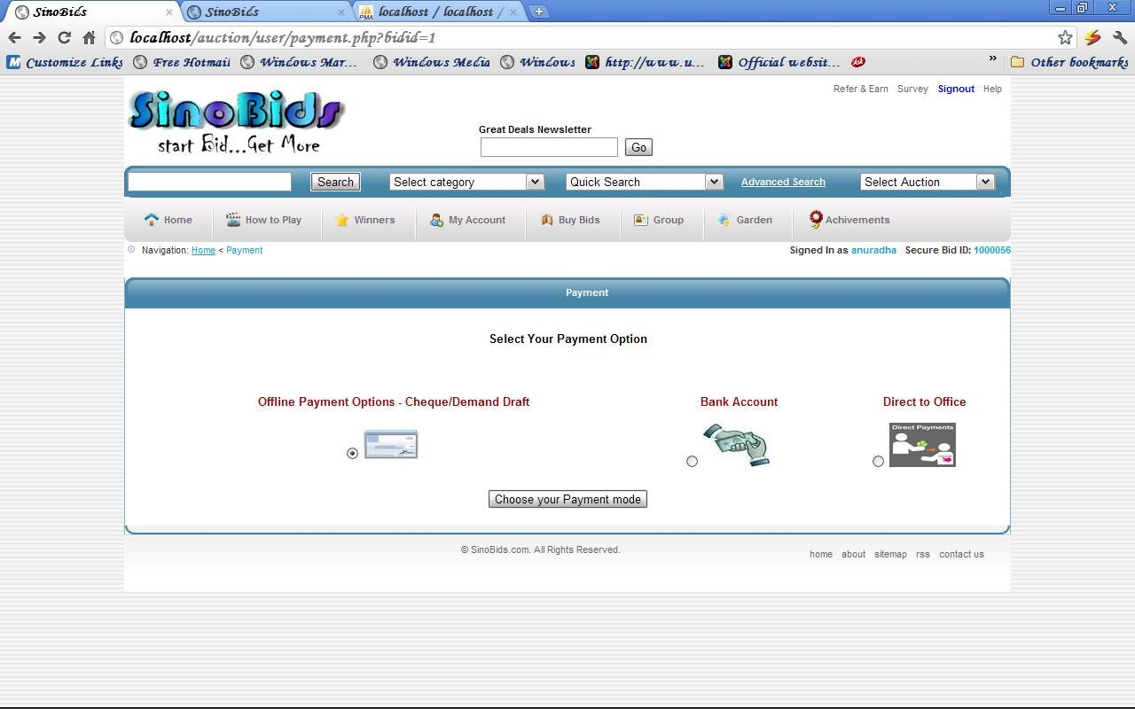
FORM NAME : Payment form
DESCRIPTION : Used to choose the payment mode

Slide 65
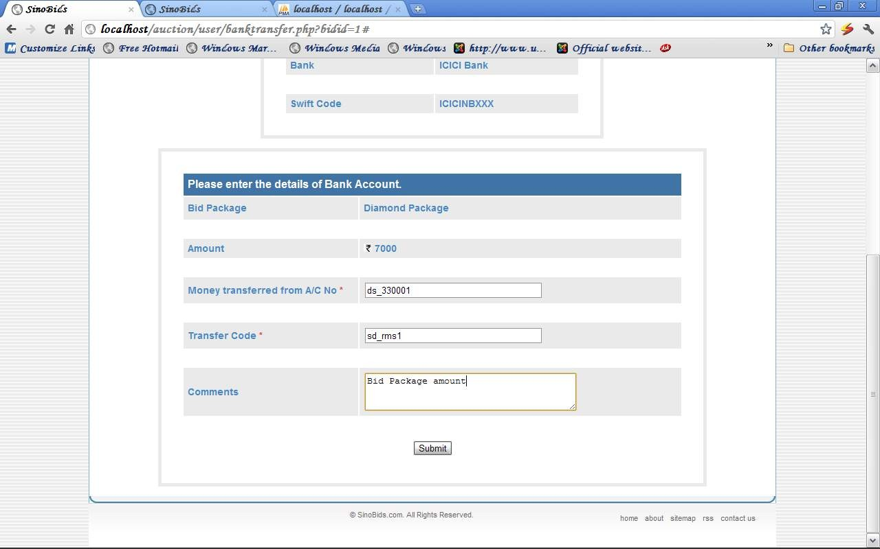
FORM NAME : Bank Transfer form DESCRIPTION : Used to enter the bank transfer

Slide 66
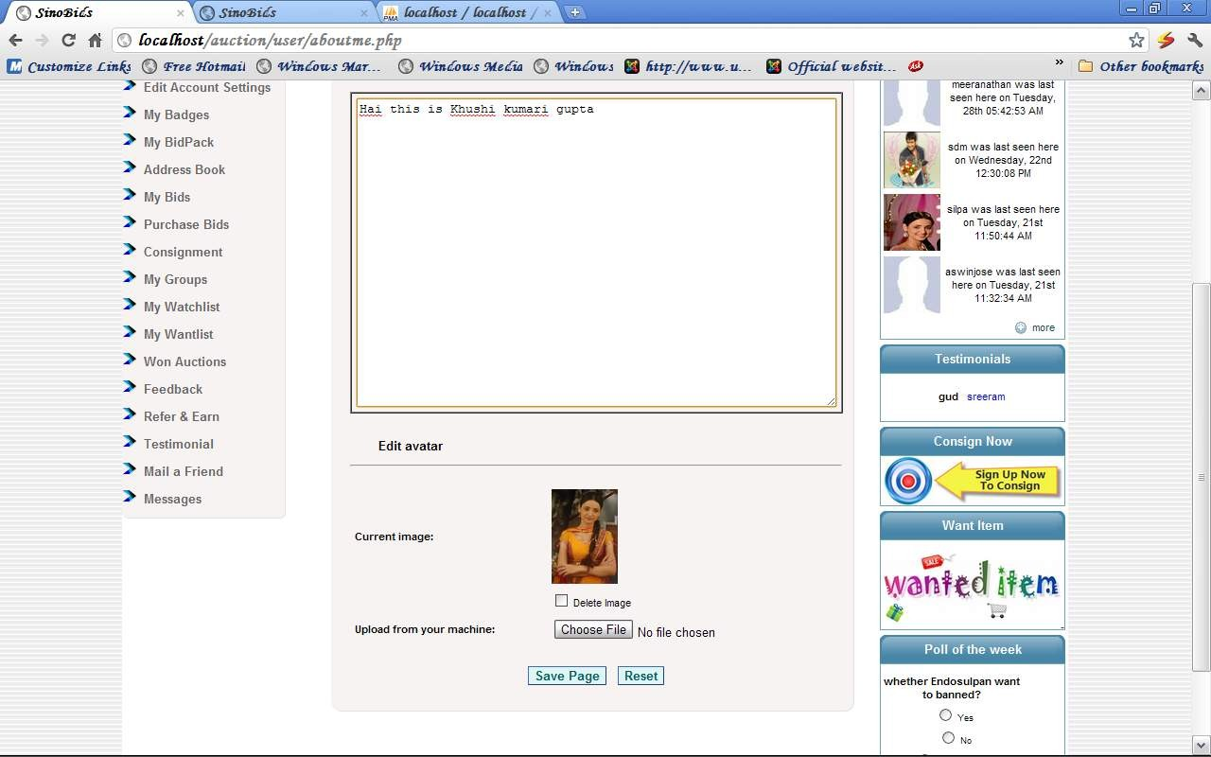
FORM NAME : About me form
DESCRIPTION : Used to enter the about me & photo

Slide 67
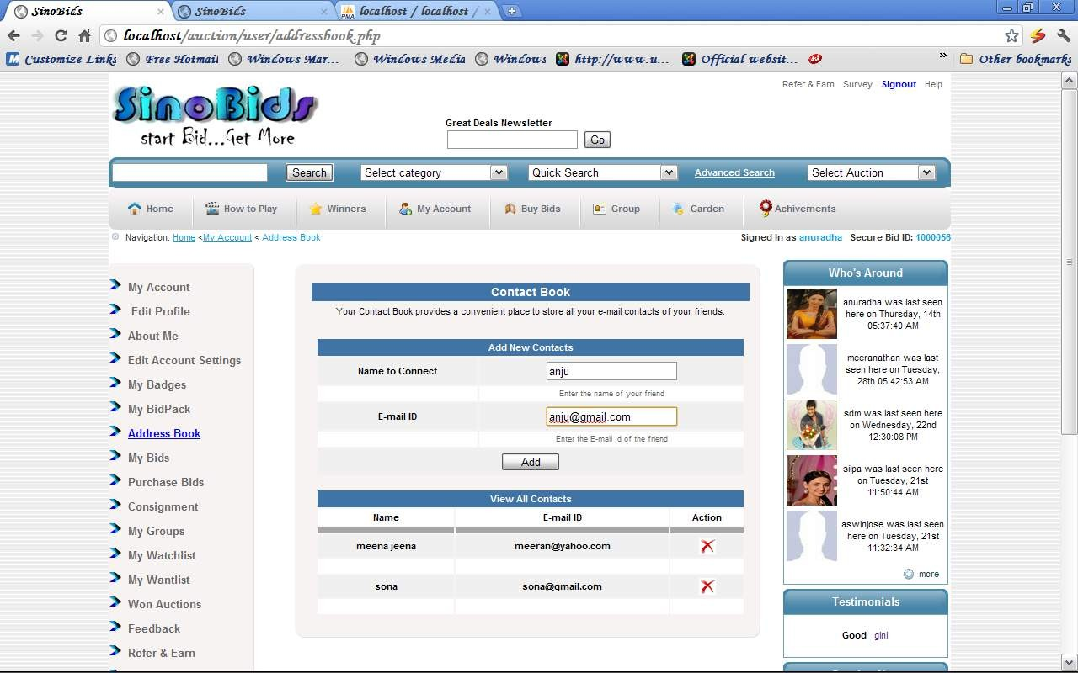
FORM NAME : Address book form
DESCRIPTION : Used to enter the email Id’s of all friends

Slide 68
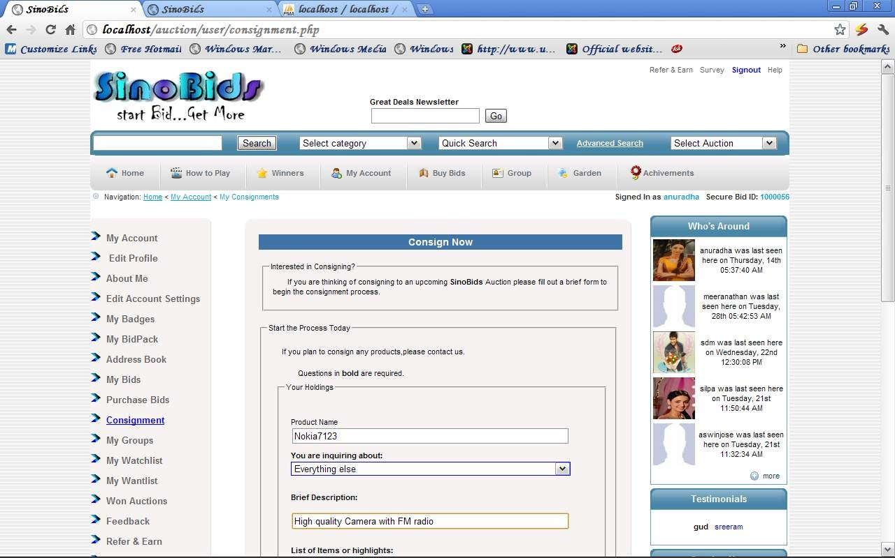
FORM NAME : Address book form
DESCRIPTION : Used to enter the email Id’s of all friends

Slide 69
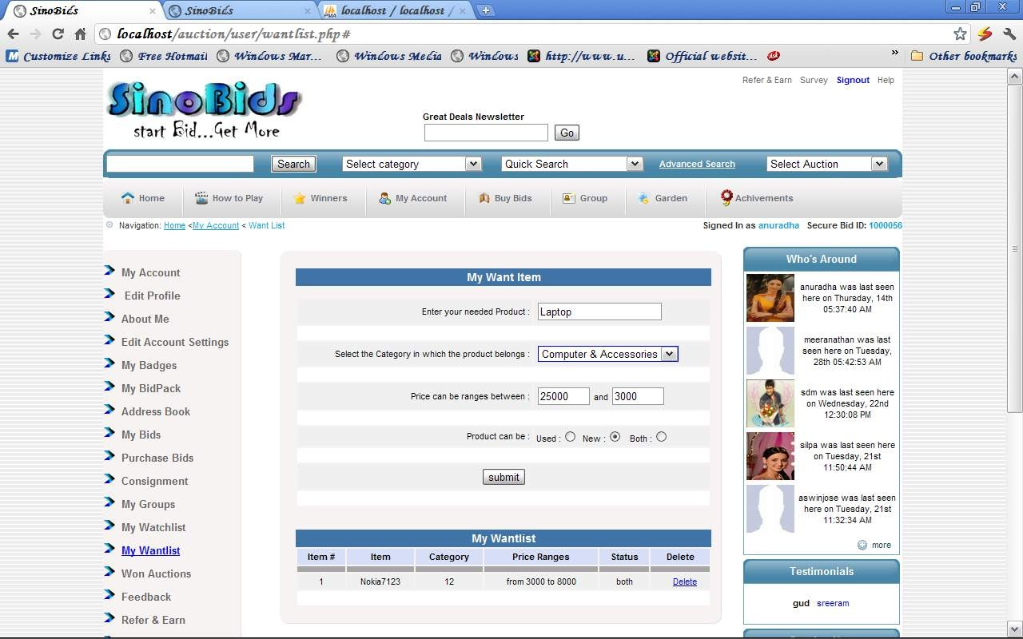
FORM NAME : Want item form DESCRIPTION : Used to enter the wanted item

Slide 70
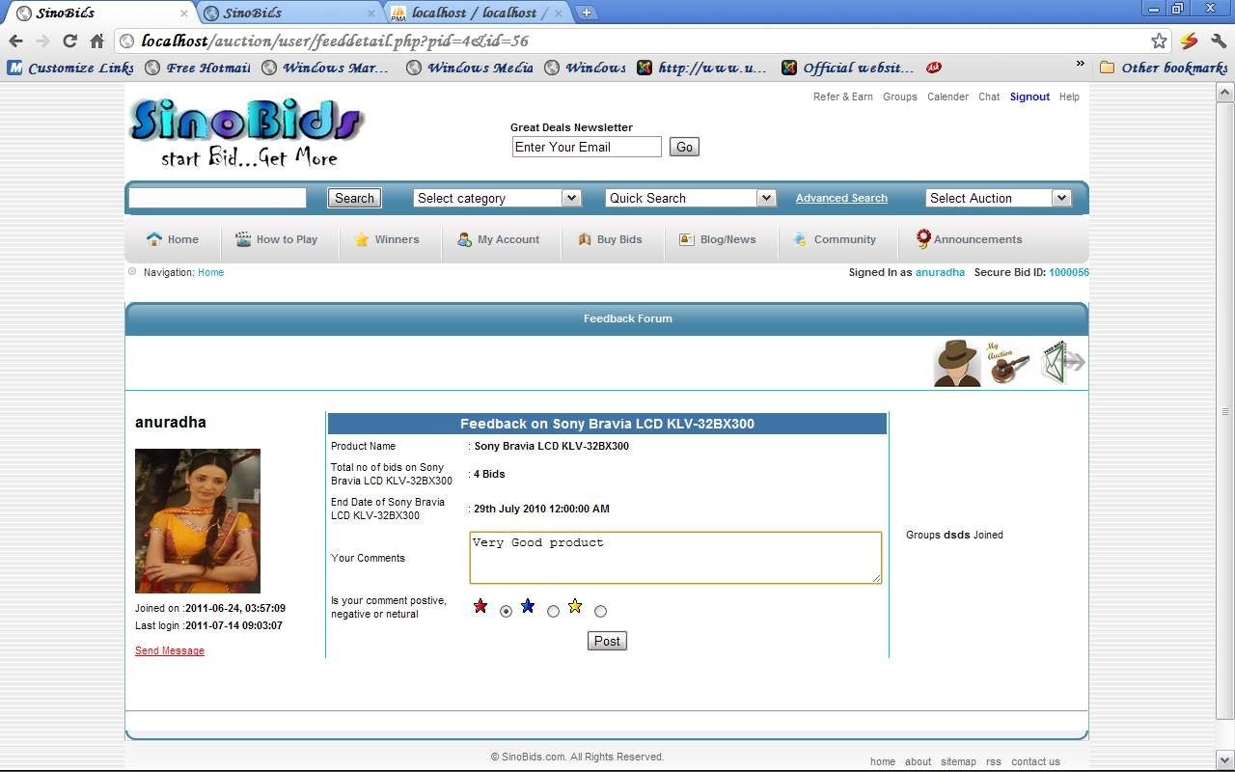
FORM NAME : Feedback form DESCRIPTION : Used to enter the feedback

Slide 71

FORM NAME : Testimonial form DESCRIPTION : Used to enter the testimonial

Slide 72

FORM NAME : Mailing form DESCRIPTION : Used to send email

Slide 73

FORM NAME : Messing form DESCRIPTION : Used to send message

Slide 74

FORM NAME : Forgot Password form
DESCRIPTION : Used to enter the change password

Slide 75

FORM NAME : Reply form
DESCRIPTION : Used to send reply to the message

Slide 76

FORM NAME : Newsletter form
DESCRIPTION : Used to enter the email ID for newsletter

Slide 77

FORM NAME : Account Setting form DESCRIPTION : Used to change password & email

Slide 78

FORM NAME : wall form
DESCRIPTION : Used to enter the wall comment

Slide 79

FORM NAME : Garden comment form DESCRIPTION : Used to enter the comment

Slide 80

Administrator Area - Input Forms
FORM NAME : Loginform
DESCRIPTION : Used to login to the application.

Slide 81

FORM NAME : Site setup Page
DESCRIPTION : Used to add & edit site setup details.

Slide 82

FORM NAME : Add Category
DESCRIPTION : Used to add category.

Slide 83

FORM NAME : Edit Category DESCRIPTION : Used to edit category.

Slide 84

FORM NAME : Add Product DESCRIPTION : Used to add product.

Slide 85

FORM NAME : Edit Product DESCRIPTION : Used to edit product.

Slide 86

FORM NAME : Auction Listing
DESCRIPTION : Used to list the auction type for the product.

Slide 87

FORM NAME : Add Bid Package
DESCRIPTION : Used to add bid package.

Slide 88

FORM NAME : Edit Bid Package DESCRIPTION : Used to edit bid package.

Slide 89

FORM NAME : Add Group DESCRIPTION : Used to add group.

Slide 90

FORM NAME : Add Newsletter DESCRIPTION : Used to add newsletter.

Slide 91

FORM NAME : Add QuikSearch DESCRIPTION : Used to quiksearch

Slide 92

FORM NAME : Add Sortlist DESCRIPTION : Used to add sortlist

Slide 93

FORM NAME : Add Auction Type DESCRIPTION : Used to add auction type

Slide 94

FORM NAME : Payment Remainder DESCRIPTION : Used to send payment remainder

Slide 95

FORM NAME : Peak Auction
DESCRIPTION : Used to enter the time of peak auction

Slide 96

FORM NAME : Add Badge DESCRIPTION : Used to add badge

Slide 97

FORM NAME : Add Payment Remainder DESCRIPTION : Used to add payment remainder

Slide 98

FORM NAME : Add Shipping Charge DESCRIPTION : Used to add shipping charge

Slide 99

FORM NAME : Add Feedback Details DESCRIPTION : Used to add feedback detail

Slide 100

FORM NAME : Add Poll Details
DESCRIPTION : Used to add poll detail

Slide 101


Output Design
User Area
Admin Area

Slide 102

User Area - Output Form
FORM NAME : Index Page
DESCRIPTION : Home page of the site.

Slide 103

FORM NAME : How to play Page
DESCRIPTION : Used to know how to play auction.

Slide 104

FORM NAME
: Winners

Slide 105

FORM NAME
: Type of Auction

Slide 106

FORM NAME
: Search Product

Slide 107

FORM NAME
: Product Details

Slide 108

FORM NAME
: Members List

Slide 109

FORM NAME
: Profile Page

Slide 110

FORM NAME
: Profile Page – My Auction

Slide 111

FORM NAME
: Feedback profile

Slide 112

FORM NAME
: Testimonial

Slide 113

FORM NAME
: Wanted Item

Slide 114

FORM NAME
: Achievement

Slide 115

FORM NAME
: Welcome Page

Slide 116

FORM NAME
: My Profile

Slide 117

FORM NAME
: My Badge

Slide 118

FORM NAME
: My BidPack

Slide 119

FORM NAME
: My Bid

Slide 120

FORM NAME
: My Group

Slide 121

FORM NAME
: My Watchlist

Slide 122

FORM NAME
: My WonAuction

Slide 123

FORM NAME
: Feedback Profile

Slide 124

FORM NAME
: Feedback on won auction

Slide 125

FORM NAME
: Group Index

Slide 126

FORM NAME
: Group Home

Slide 127

FORM NAME
: Garden Home

Slide 128

FORM NAME
: Garden Comment

Slide 129

Administrator Area- Output Form
TABLE NAME : Home Page

Slide 130

TABLE NAME
: Category List

Slide 131

TABLE NAME
: User Suggested Category

Slide 132

TABLE NAME
: Consignment

Slide 133

TABLE NAME
: Todays Special

Slide 134

TABLE NAME
: Wantlist

Slide 135
TABLE NAME
: Wantlist

Slide 136

TABLE NAME
: Bid Package

Slide 137

TABLE NAME
: User Requested Bid Package

Slide 138

TABLE NAME
: View Group

Slide 139

TABLE NAME
: User Suggested Group

Slide 140

TABLE NAME
: User Suggested Ideas

Slide 141

TABLE NAME
: View Users Comments

Slide 142

TABLE NAME
: Newsletter Contact

Slide 143

TABLE NAME
: User Management

Slide 144

TABLE NAME
: User Details

Slide 145

TABLE NAME
: View Bids

Slide 146

TABLE NAME
: User Activation

Slide 147

TABLE NAME
: Contact List

Slide 148

TABLE NAME
: Pending Winners

Slide 149

TABLE NAME
:Winners

Slide 150

TABLE NAME
:View Badges

Slide 151
Database Design
TABLE NAME : admin
DESCRIPTION : Used to store admin details.
Attribute | Data Type | Width | Description
id | integer | 10 | Primary key
uname | varchar | 50 | Not null
pwd | varchar | 50 | Not null
TABLE NAME : cat_tb
DESCRIPTION : Used to store the details of different types of category.
Data Width
Type
int 11
varchar 50
Description
Attribute
id
Primary key
cat
Not null
photo
text
Not null

Slide 152
TABLE NAME : auctiontype_tb
DESCRIPTION : Used to store the details of different types of auction.
Attribute | Data Type | Width | Description
id | int | 11 | Primary key
auctiontype | varchar | 100 | Not null
: ibmadaggee | text |  | Not null
Used to store the de des | tails of different text | types of badge. | Not null
Attribute | Data Type | Width | Description
id | int | 11 | Primary key
Badge | varchar | 100 | Not null
photo | text |  | Not null
Des | text |  | Not null
TABLE NAME DESCRIPTION :

Slide 153
TABLE NAME : badgewin
DESCRIPTION : Used to store the details of user who gained the badges
Attribute | Data Type | Width | Description
id | int | 11 | Primary key
userid | int | 11 | Foreign Key(register(id))
badge | int | 11 | Foreign Key(badge(id))
TABLE NAME
DESCRIPTION
: bank
: Used to store th
e details of paym
ent through bank
transfer.
Data Type
Width
Description
Attribute
id
int
11
Primary key
userid
int
11
Foreign Key(register(id))
type
varchar
100
Not null

Slide 154
TABLE NAME : bid
DESCRIPTION : Used to store the details of the bid history
Attribute | Data Type | Width | Description
id | int | 11 | Primary key
userid | int | 11 | Foreign Key(register(id))
pid | int | 11 | Foreign Key(product_tb(id))
bidpack | int | 11 | Foreign Key(bidpack(bidid))
bidprice | int | 11 | Not null
bidbal | int | 11 | Not null
biddate | date |  | Not null
bidtime | time |  | Not null

Slide 155
TABLE NAME : bidcount
DESCRIPTION : Used to stores the bid package count of each users
Attribute | Data Type |  | Width |  | Description
id | int |  | 11 |  | Primary key
userid | int |  | 11 |  | Foreign Key(register(id))
bidpack E : bidpack ON : Used to sto | int res details of di |  | 11 fferent bid pack |  | Foreign ªK^{ge}e^{s}y(bidpack(bidid))
Attribute |  | Data Type |  | Width |  | Description
bidid |  | int |  | 11 |  | Primary key
types |  | varchar |  | 100 |  | Not null
num |  | int |  | 11 |  | Not null
price |  | int |  | 11 |  | Not null
TABLE NAM
DESCRIPTI
num i
nt 11
Not
null

Slide 156
TABLE NAME : bidtemp
DESCRIPTION : Used to stores the last bid details of the auction items.
Attribute | Data Type | Width | Description
id | int | 11 | Primary key
pid | int | 11 | Foreign Key(product_tb(id))
lastbidderid | int | 11 | Foreign Key(register(id))
lastbidrate | int | 11 | Not null
counttemp | int | 11 | Not null
bidtime | time |  | Not null
biddate | date |  | Not null

Slide 157
TABLE NAME : cheque
DESCRIPTION : Used to stores the details of payment through cheque.
Attribute | Data Type | Width | Description
id | int | 11 | Primary key
userid | int | 11 | Foreign Key(register(id))
type | varchar | 100 | Not null
amount | int | 50 | Not null
chequeno | varchar | 100 | Not null
bankdetails | text |  | Not null
favourof | text |  | Not null
payable | text |  | Not null

Slide 158
TABLE NAME : consignment
DESCRIPTION : Used to stores the details of consignments.
Attribute | Data Type | Width | Description
id | int | 11 | Primary key
userid | int | 11 | Foreign Key(register(id))
prodname | varchar | 100 | Not null
cat | int | 11 | Foreign Key(cat_tb(id))
brief | text |  | Not null
highlights | text |  | Not null
acquire | varchar | 150 | Not null
price | int | 11 | Not null
image | text |  | Not null
email | text |  | Not null
fname | varchar | 100 | Not null
lname | varchar | 100 | Not null
phone | int | 11 | Not null

Slide 159
TABLE NAME : emailadd
DESCRIPTION : Used to store the email id of the user’s friends for mailing.
Attribute | Data Type | Width | Description
Id | int | 11 | Primary key
userid | int | 11 | Foreign Key(register(id))
name | varchar | 100 | Not null
ME : feedback O^{e}N^{ma}:^{i}U^{lid}sed to st | o^{te}re^{xt}the details of | feedback hist | _{o}N_{ry}o. t null
TABLE NA
DESCRIPTI
Attribute | Data Type | Width | Description
Id | int | 11 | Primary key
userid | int | 11 | Foreign Key(register(id))
topicid | int | 11 | Foreign Key(product_tb(id))
type | varchar | 60 | Not null
comment | text |  | Not null

Slide 160
TABLE NAME : feedbackcount
DESCRIPTION : Used to store the details of the feedback count history.
Attribute | Data Type | Width | Description
Id | int | 11 | Primary key
userid | int | 11 | Foreign Key(register(id))
comments | int | 11 | Not null
positive | int | 11 | Not null
negative | int | 11 | Not null
neutral | int | 11 | Not null
total | float |  | Not null
TABLE NAME
DESCRIPTIO
: feedbackde
N : Used to stor
s
e the different t
ypes of feedbac
k reputations.
Attribute | Data Type | Width | Description
Id | int | 11 | Primary key
icon | text |  | Not null
feedback | varchar | 50 | Not null

Slide 161
TABLE NAME : garden
DESCRIPTION : Used to store the details of the garden comment.
Attribute | Data Type | Width | Description
Id | int | 11 | Primary key
gardenid | int | 11 | Foreign Key(gardenmaster(id))
userid | int | 11 | Foreign Key(register(id))
ownerid | int | 11 | Foreign Key(register(id))
comments | text |  | Not null
commentdate | date |  | Not null
commentstatu s | int | 11 | Not null

Slide 162
TABLE NAME : gardenmaster
DESCRIPTION : Used to stores the different types of comments for the garden
Attribute | Data Type | Width | Description
Id | int | 11 | Primary key
userid | int | 11 | Foreign Key(register(id))
ideas | text |  | Not null
post | int | 11 | Not null
neg | int | 11 | Not null
neut | int | 11 | Not null
status | int | 11 | Not null
comment | int | 11 | Not null

Slide 163
TABLE NAME : group1
DESCRIPTION : Used to stores the details of the user who joined in the group
Attribute | Data Type | Width | Description
Id | int | 11 | Primary key
groupid | int | 11 | Foreign Key(groupmaster(id))
userid | int | 11 | Foreign Key(register(id))
: groupmaster r:eUgsdeadteto store | sdathtee different ty | pes of groups | Not null
TABLE NAME DESCRIPTION
Attribute | Data Type | Width | Description
Id | Int | 11 | Primary key
cat | Varchar | 100 | Not null
photo | text |  | Not null
groupdet | text |  | Not null
createdate | date |  | Not null

Slide 164
TABLE NAME : liveonly
DESCRIPTION : Used to store the date for the live only auctions.
Attribute | Data Type | Width | Description
Id | int | 11 | Primary key
pid | int | 11 | Foreign Key(product_tb(id))
livedate | date |  | Not null
TABLE NAME
DESCRIPTION : Used to stores the messages for the user.
:message
Attribute | Data Type | Width | Description
Id | int | 11 | Primary key
userid | int | 11 | Foreign Key(register(id))
sender | int | 11 | Foreign Key(register(id))
message | text |  | Not null

Slide 165
TABLE NAME : newsletter
DESCRIPTION : Used to stores the contents of the newsletter.
Attribute | Data Type | Width | Description
Id | int | 11 | Primary key
name | text |  | Not null
content | text |  | Not null
ewslettermail Upsoesdtdtoatsetores | thdeateemail contac | ts for the newsl | eNtteort null
TABLE NAME n DESCRIPTION :
Attribute | Data Type | Width | Description
Id | int | 11 | Primary key
mailid | text |  | Not null

Slide 166
TABLE NAME : paymentrem
DESCRIPTION : Used to stores the payment remainder contents
Attribute | Data Type | Width | Description
Id | int | 11 | Primary key
title | varchar | 100 | Not null
des | text |  | Not null
TABLE NAME
DESCRIPTION : Used to stores the time for the peak auctions.
:peakauctio
n
Attribute | Data Type | Width | Description
id | int | 11 | Primary key
pid | int | 11 | Foreign Key(product_tb(id))
settime | time |  | Not null

Slide 167
TABLE NAME : pollanswer
DESCRIPTION : Used to stores the answers for the poll.
AME :poll ION : Use | Attribute |  | Data Type |  | Width |  | Description
 | pollAnswerID |  | int |  | 11 |  | Primary key
 | pollID |  | int |  | 11 |  | Foreign Key(polls(pollID))
 | pollAnswerValu e |  | varchar |  | 250 |  | Not null
 | s _{d}po_{t}l_{o}lA_{st}n_{o}s_{r}w_{es}er_{t}P_{h}o_{e}in_{po} |  | l^{i}l^{n}q^{t}uestions. |  | 11 |  | Not null
Attribute |  | Data Type |  | Width |  | Description
pollID |  | int |  | 11 |  | Primary key
pollQuesti | _{o}n_{n}g | varchar |  | 250 |  | Not null
pollStatus |  | tinyint |  | 4 |  | Not null
TABLE N DESCRIPT
t
pollAns
werListi int
11
Not null

Slide 168
TABLE NAME : product_tb
DESCRIPTION : Used to stores the details of products.
Attribute | Data Type | Width | Description
id | int | 11 | Primary key
prodname | varchar | 50 | Not null
retailprice | int | 11 | Not null
cat | int | 11 | Foreign Key(cat_tb(id))
photo | text |  | Not null
proddes | text |  | Not null
startdate | datetime |  | Not null
enddate | datetime |  | Not null
types | varchar | 50 | Not null
status | int | 11 | Not null
counttemp | int | 11 | Not null

Slide 169
TABLE NAME : quicksearch_tb
DESCRIPTION : Used to stores the quick search drop down list content
Attribute | Data Type | Width | Description
id | int | 11 | Primary key
s:ereafrecrheiatermn | varchar | 100 | Not null
TABLE NAME
DESCRIPTION : Used to stores the details of the person who registered by referring.
Attribute | Data Type | Width | Description
id | int | 11 | Primary key
email | text |  | Not null
regdate | date |  | Not null
regid | int | 11 | Foreign Key(register(id))
userid | int | 11 | Foreign Key(register(id))

Slide 170
TABLE NAME : register DESCRIPTION : Used to stores the details of users
Attribute | Data Type | Width | Description
id | int | 10 | Primary key
reg | int | 11 | Not null
retailprice | int | 11 | Not null
fname | varchar | 50 | Not null
lname | varchar | 50 | Not null
cname | varchar | 100 | Not null
dob | date |  | Not null
gender | varchar | 50 | Not null
add1 | varchar | 100 | Not null
add2 | varchar | 100 | Not null
city | varchar | 50 | Not null
state | varchar | 50 | Not null
zip | int | 11 | Not null
Country | varchar | 50 | Not null
creg | varchar | 50 | Not null
phone | int | 11 | Not null
email | varchar | 150 | Not null
mob | int | 11 | Not null
uname | varchar | 50 | Not null
pass | varchar | 50 | Not null
regdate | date |  | Not null
logindate | datetime |  | Not null
regtime | time |  | Not null
active | int | 11 | Not null
suspend | int | 11 | Not null
verifyemail | int | 11 | Not null
textdesc | text |  | Not null
photo | text |  | Not null
newsletter | int | 11 | Not null

Slide 171
TABLE NAME : requestbid
DESCRIPTION : Used to stores details of all requested bid package
Attribute | Data Type | Width | Description
id | int | 11 | Primary key
userid | int | 11 | Foreign Key(register(id))
bidid | int | 11 | Foreign Key(bidpack(bidid))
biddate | datetime |  | Not null
paymentmode | varchar | 100 | Not null
status | varchar | 50 | Not null
TABLE NAME :shipping
DESCRIPTION : Used to stores the details of shipping charges
Attribute | Data Type | Width | Description
id | int | 11 | Primary key
state | varchar | 100 | Not null
shipping_price | int | 10 | Not null

Slide 172
TABLE NAME : sitesetup
DESCRIPTION : Used to stores the details of site setup
Attribute | Data Type | Width | Description
id | int | 11 | Primary key
sitename | varchar | 100 | Not null
sitepath | varchar | 100 | Not null
adminemail | text |  | Not null
photo | text |  | Not null
TABLE NAME :so DESCRIPTION : Us
rt
ed to stores the so
rt drop down li
st content.
Attribute | Data Type | Width | Description
id | int | 11 | Primary key
sortlist | varchar | 50 | Not null

Slide 173
TABLE NAME : suggroup
DESCRIPTION : Used to stores the details of the user suggested group
Attribute | Data Type | Width | Description
id | int | 11 | Primary key
group | varchar | 100 | Not null
groupdet | text |  | Not null
groupsug | text |  | Not null
sugby | int | 11 | Foreign Key(register(id))
TABLE NAME :todays_special
DESCRIPTION : Used to stores the details of today’s special product
Attribute | Data Type | Width | Description
id | int | 11 | Primary key
pid | int | 11 | Foreign Key(product_tb(id))
todate | date |  | Not null

Slide 174
TABLE NAME : survey
DESCRIPTION : Used to stores the details of site survey
Attribute | Data Type | Width | Description
id | int | 11 | Primary key
userid | int | 11 | Foreign Key(register(id))
valuedeal | varchar | 10 | Not null
easepurchaase | varchar | 10 | Not null
customservice | varchar | 10 | Not null
shippingcharge | varchar | 10 | Not null
deliveryprod | varchar | 10 | Not null
aucprefer | int | 10 | Not null
shopcont | int | 10 | Not null
cat | int | 11 | Foreign Key(cat_tb(id))
catprefer | varchar | 10 | Not null
txtOther1 | varchar | 100 | Not null
searchitem | int | 11 | Foreign Key(qiucksearch_tb(id))
recom | int | 11 | Not null
visit | int | 11 | Not null
ideas | text |  | Not null

Slide 175
TABLE NAME :testimonial
DESCRIPTION : Used to stores the details of the testimonials.
Attribute | Data Type | Width | Description
id | int | 11 | Primary key
userid | int | 11 | Foreign Key(register(id))
title | varchar | 200 | Not null
testimonial | text |  | Not null
:userbidpack Ustsaetudsto store the c | ovmarpclheater history | o1f0u0ser bid packa | gNe ot null
TABLE NAME
DESCRIPTION :
Attribute | Data Type | Width | Description
id | int | 11 | Primary key
userid | int | 11 | Foreign Key(register(id))
bidpack | int | 11 | Foreign Key(bidpack(bidid))
packdate | date |  | Not null
packtime | time |  | Not null

Slide 176
TABLE NAME :wall
DESCRIPTION : Used to stores the wall details posted by user.
Attribute | Data Type | Width | Description
id | int | 11 | Primary key
memid | int | 11 | Foreign Key(register(id))
groupid | int | 11 | Foreign Key(groupmaster(id))
wall | text |  | Not null
TABLE NAME :watchlist
DESCRIPTION : Used to stores the watch list details.
Attribute | Data Type | Width | Description
watchid | int | 11 | Primary key
userid | int | 11 | Foreign Key(register(id))
pid | int | 11 | Foreign Key(product_tb(id))

Slide 177
TABLE NAME :wantlist
DESCRIPTION : Used to stores the want items details.
Attribute | Data Type | Width | Description
id | int | 11 | Primary key
userid | int | 11 | Foreign Key(register(id))
cat | int | 11 | Foreign Key(cat_tb(id))
prodname | varchar | 100 | Not null
start_price | int | 11 | Not null
end_price | int | 11 | Not null
status | varchar | 50 | Not null

Slide 178
TABLE NAME :winners
DESCRIPTION : Used to stores the details of winners.
Attribute | Data Type | Width | Description
id | int | 11 | Primary key
userid | int | 11 | Foreign Key(register(id))
pid | int | 11 | Foreign Key(product_tb(id))
winbid | int | 11 | Not null
total_charge | int | 11 | Not null
status | varchar | 100 | Not null

Slide 179

Normalization
A relation is said to be in a particular normal form if it satisfies a certain specified set of constraints on the kind of functional dependencies that could be associated with the relation
This site satisfies First Normal Form ,
by eliminating repeated groups by creating separate tables for each set of related data.
This site satisfies Second Normal Form;
by creating separate tables for sets of values that apply to multiple records and relate these tables through foreign keys.
This site Third Normal Form;
by eliminating fields that do not depend on the key from the original
table and add them to the table whose primary key is their determinant.

Slide 180



System Testing
System Testing is a process, which reveals errors in the program. The different testing steps done in this site are
Unit Testing
Integration Testing
Black Box Testing
White Box Testing
Acceptance Testing
Validation Testing

Slide 181

System Testing
Unit Testing
In this site, unit testing is done in every module,
tested validations for each step used in programming.
Required fields are written for the code to be working properly.
Integration Testing
Here all modules are combined in this testing step.
The entire program is tested as a whole.
Correction is difficult at this stage because the isolation of causes is complicated by the vast expense of the entire program
Thus in the integration testing step all the errors uncover are corrected for the next testing step.

Slide 182

System Testing
Black Box Testing
Each function developed in the software are selected carefully and checked for the performance.
Each result is compared with the actual or expected result.
The procedure is repeated for the confirmation of the test
result.
Software is checked using multiple users and tested whether it works properly for the administrator and other users allowing authorization rules.
White Box Testing
Windows commands and built-in functions in the PHP are used in the code studied carefully and checked whether it is implemented in the proper way or in proper place.
Line by line flow of code checked.

Slide 183

System Testing
Acceptance Testing
The system under consideration is tested for user acceptance by constantly keeping in touch with prospective system and user at the time of developing and making changes whenever required.
Validation Testing
All validations are tested in this phase
In our system, validations are mainly performed at the time of login, registration, bidding, payment and changing password & email.
Moreover, each code modules are tested one after another for effectiveness of errors

Slide 184

System Testing
FORM NAME : Loginform
DESCRIPTION : Checking username & password

Slide 185

FORM NAME : Register form DESCRIPTION :Checking all validations

Slide 186

FORM NAME : Account Setting form DESCRIPTION :Checking password

Slide 187

FORM NAME : Bidding form DESCRIPTION :Checking bid amount

Slide 188

FORM NAME : Payment form DESCRIPTION :Checking Validation

Slide 189



System Implementation
Implementation is the stage in the project where the theoretical design is turned into a working system and is giving confidence on the new system for the users that it will work efficiently and effectively.
The methodology used for implementing web applications contains the following steps:
Process listing
Maquetting / Wire framing / Prototyping
URL listing

Slide 190


Conclusion
The primary goal of this site ‘SinoBids Online Auction’ is to create a successful
online auction.
All the web screens contain all the information regarding the entering or updating of data
Error correction and modification for further enhancement could be made very
easily.
This site is highly portable and can be implemented in any organization without much modification of the softwares
A thorough review of the design reveals that the system objectives have been met.
This site also reduces the distribution cost of a product. It can be stored at one
place till it is ready for shipping.
It will also reduce the packaging cost of items for distribution to intermediaries such as retail stores
it is very flexible with user friendly screens enabling the user to use it without any
inconvenience
It will also protect goods from damages and keep them safe

Slide 191



Scope for Further Enhancement
The system security can be added by the option of Blacklisting
defaulting bidders and can use security provider software.
Discussion forum & annoucement forum can be done for the users.
Along with bidders, sellers can be included. There also can be
option for rating sellers & can have store facility.
Online help & online group within members can be introduced
Bid helpers can be included in the site for easy bidding.
Event Calendar facility & extended payment options can be included.
Blogs, eClassified, google search and also interaction between social networking sites
Online live video demo of the product can be included.
All the accepted new features which are suggested by the user can be introduced in the site.

Slide 192


